Slide 1

DSA & JAVA
Y . Likitha reddy
CB.SC.U4AIE24361

Slide 2
Car Rental Management System
A GUI-Based Application for Efficient Car Booking

Slide 3
Problem Statement
Why this project?
Manual car rental processes are time-consuming.
Need for an automated system to manage bookings, availability, and user accounts.
Real-life Applications:
Used by rental agencies.
Can be integrated with ride-sharing platforms.

Slide 4
Objectives
Provide a user-friendly GUI for car rentals.
Manage car availability and bookings in real-time.
Calculate rental costs efficiently.
Secure user authentication (login/signup).

Slide 5
Existing Solutions & Drawbacks
Current Solutions:
Spreadsheet-based management :Used in small rental companies, it may have manual error, and no real-time sync.
Drawbacks:
No real-time updates.
Lack of user-friendly interfaces.

Slide 6
Data Structures & Algorithms
Data Structures:
Array list:
ArrayList is the most suitable choice for storing and managing data such as cars, users, and bookings. Unlike arrays, which require a predefined size, ArrayList automatically resizes as new elements are added. This is ideal for real-time systems where the number of cars or users is constantly changing.
Algorithms:
Linear search:
Linear Search is the preferred algorithm for searching through lists of cars, users and bookings. Since Binary Search only works on sorted lists. In this project, the car list or booking data is often unsorted (e.g., cars added as they are registered). Sorting the list every time would be difficult.
Time complexity: O(n)

Slide 7
OOP Concepts Applied
1.Encapsulation:
Ensures data is secure and not directly modified from outside.
Fields (like username, car model, etc.) are private, and accessed through getters/setters.
2. Abstraction
Abstraction means hiding the complex implementation details and exposing only essential features.
Methods like bookCar(),showAvailableCars() and showBookings perform complex tasks but are called with a single line.

Slide 8
JAVA Concepts Applied
1. Swing GUI
Uses Swing components like Jbutton, JTextField to create a graphical user interface.
2. Event Handling
Action listeners like loginButton.addActionListener() responds to user actions like clicking buttons.

Slide 9
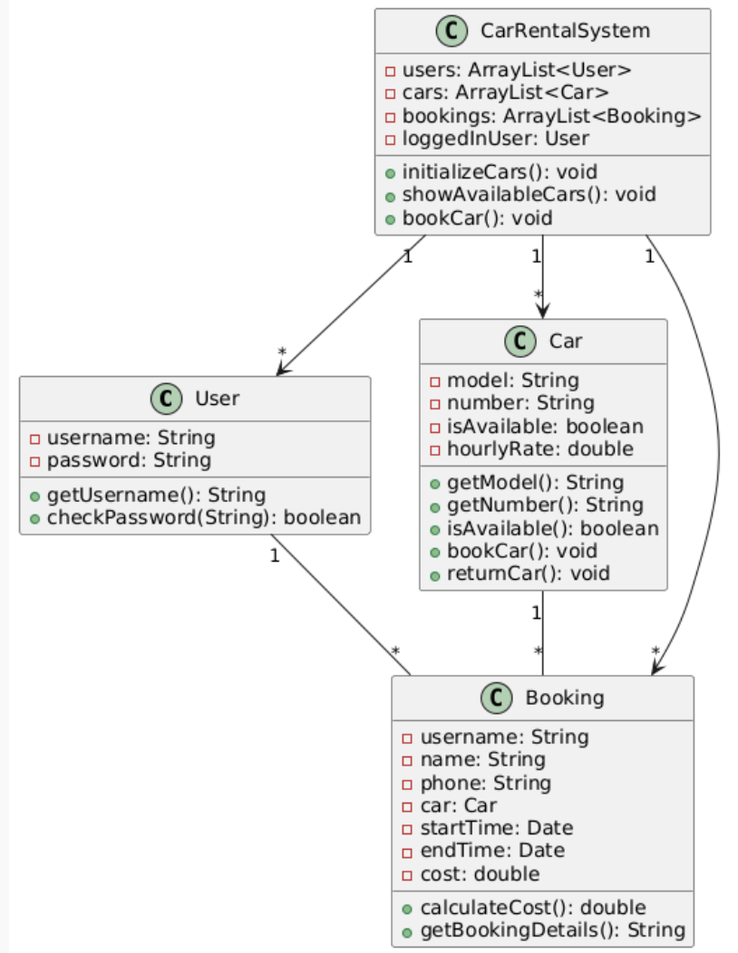
System Architecture
Class Diagram (UML)

Slide 10
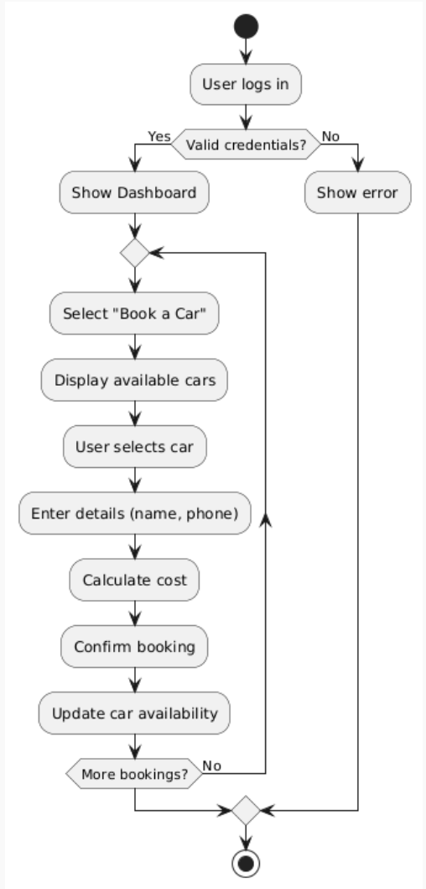
System Architecture
Flowchart

Slide 11
Module Interaction
Login/Signup: | Authenticates users.
Car Management: | Lists/book cars.
Booking System: | Handles Bookings and cost calculation.

Slide 12
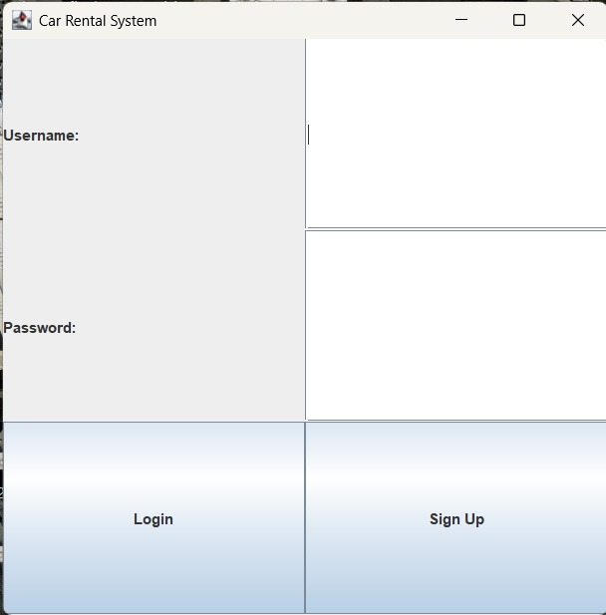
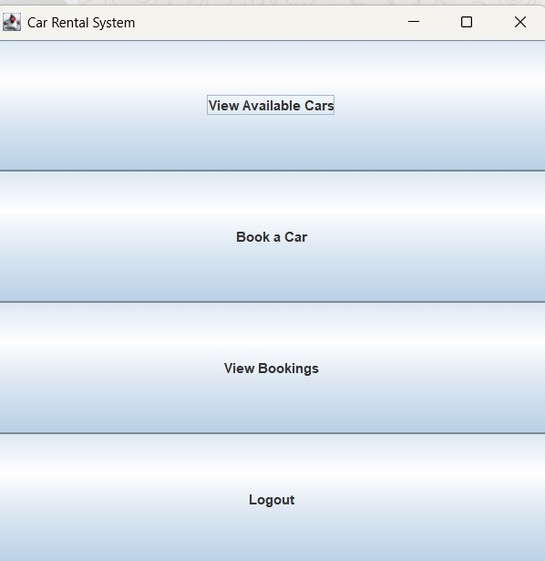
Screenshots

Slide 13
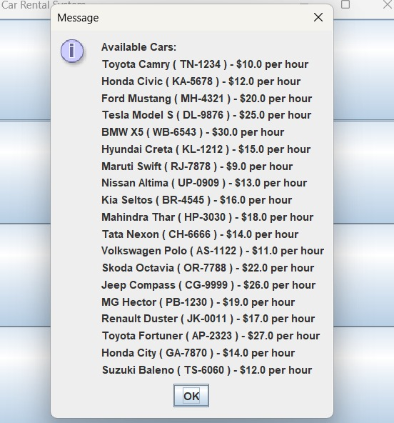
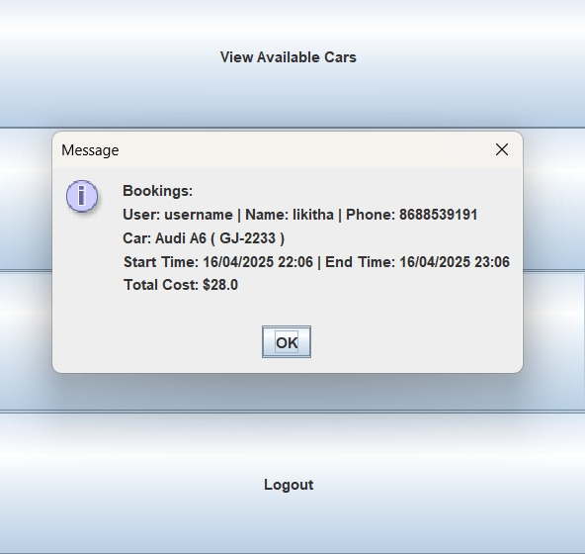
Screenshots

Slide 14
Thank
You

